Slide 1


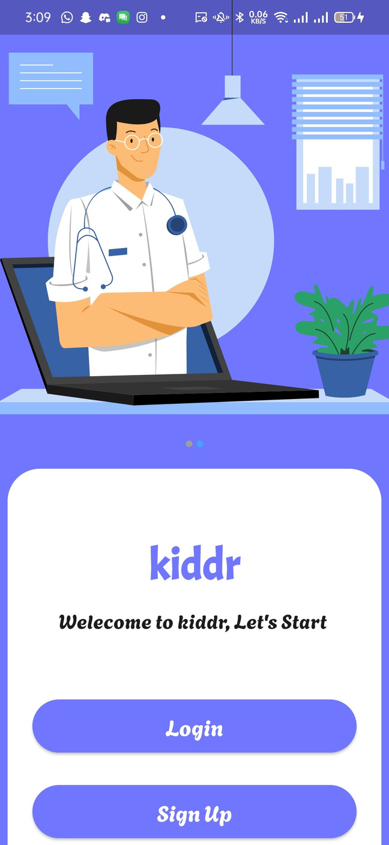
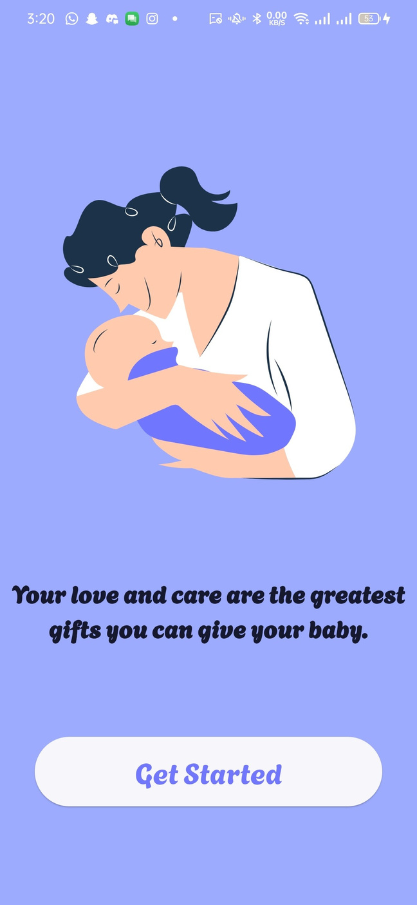

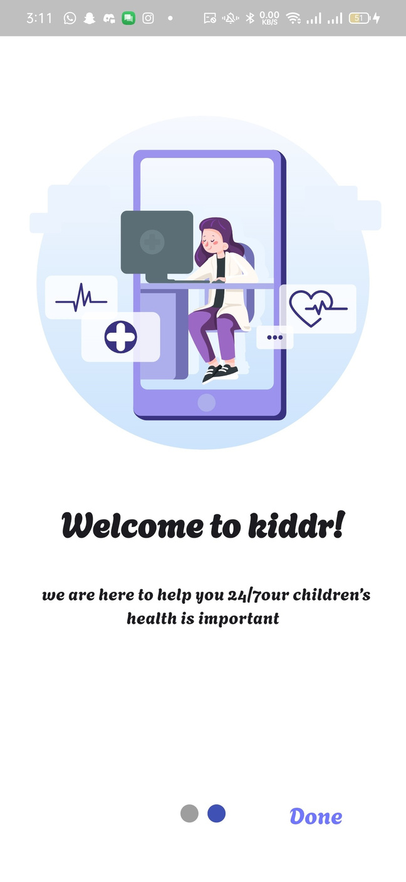
kiddr
our kids's health is importatnt

Slide 2
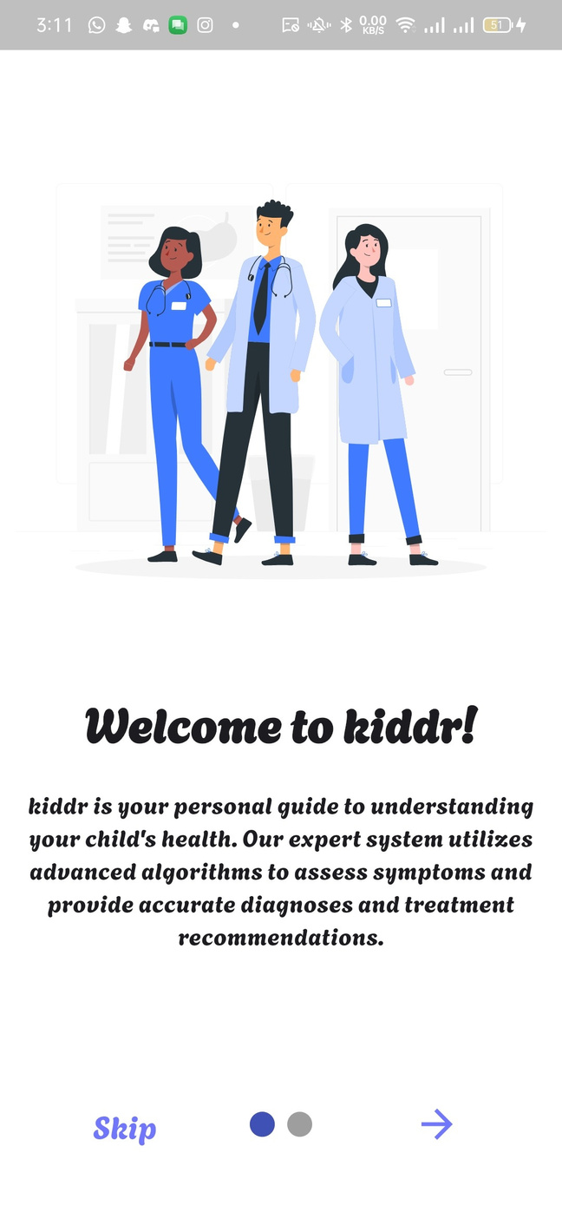
your personal guide to understand your child's health
advanced algorithms to asses symptoms and provide accurate diagnoses and treatment recommendations .

Slide 3
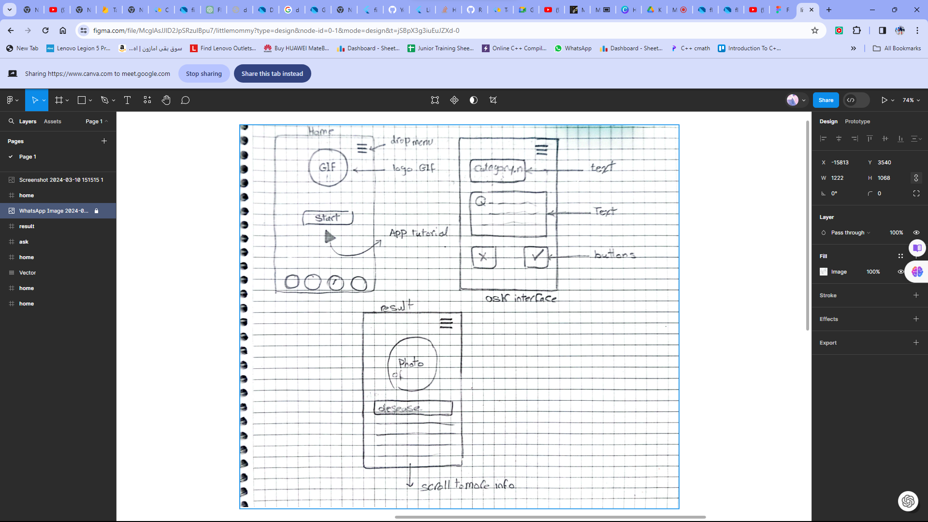
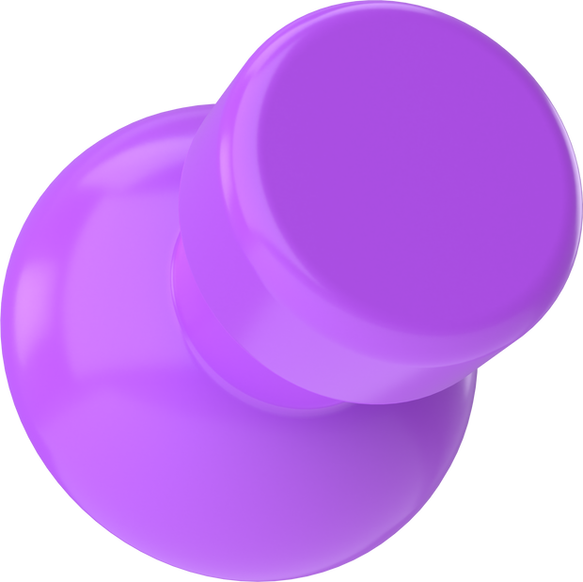
we started with an on-scratch version

Slide 4
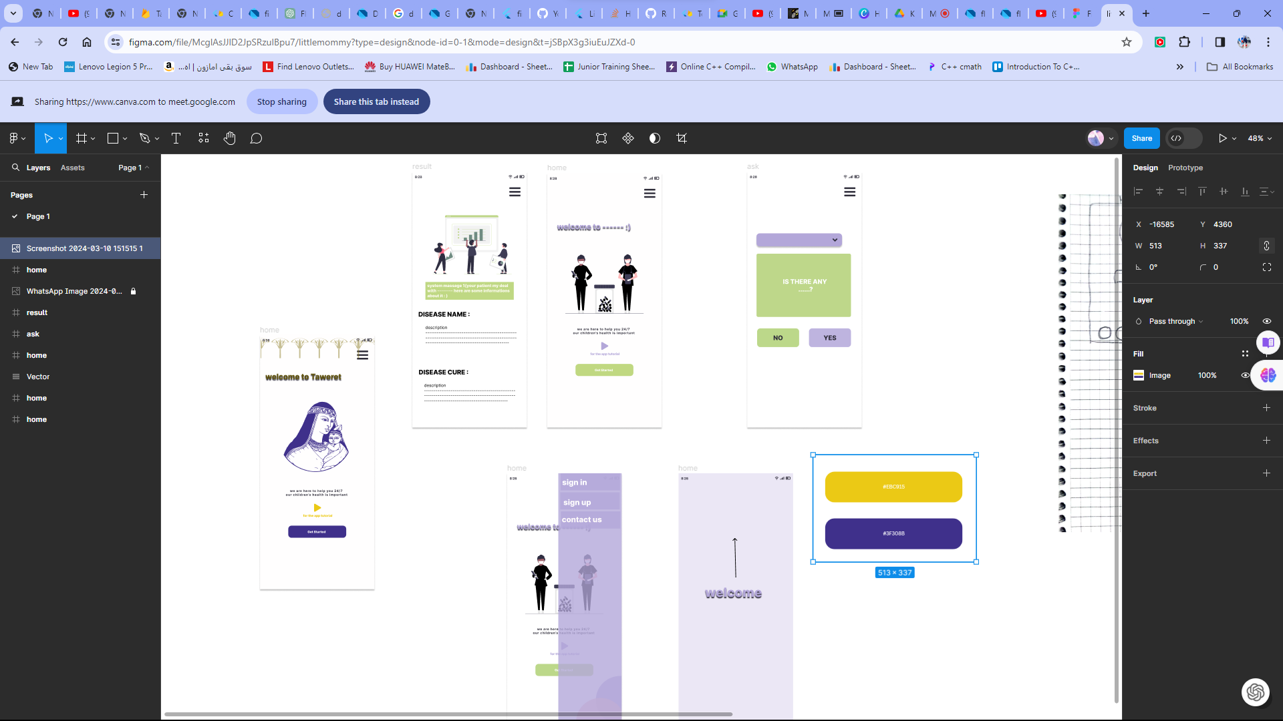


Slide 5
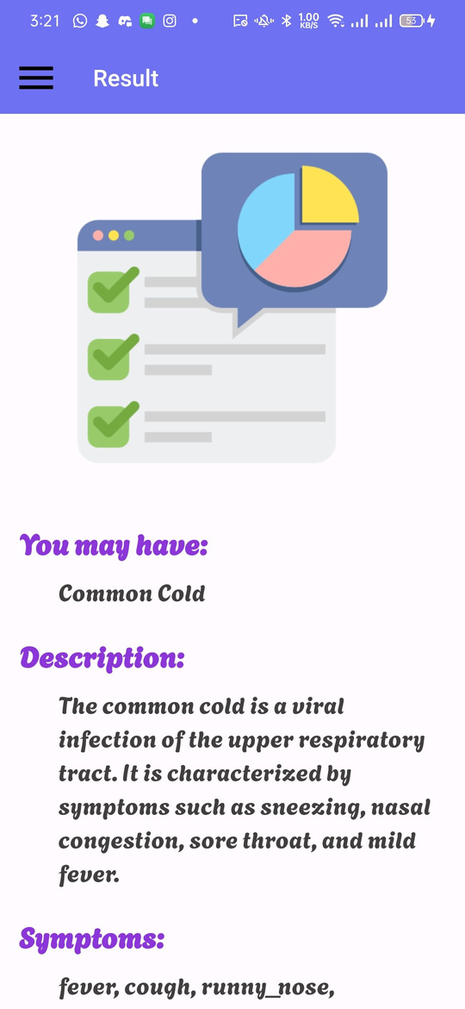
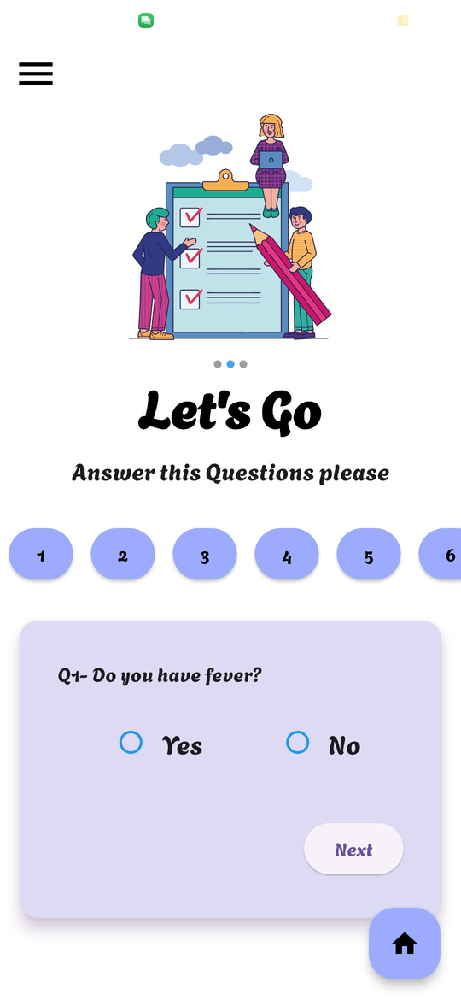
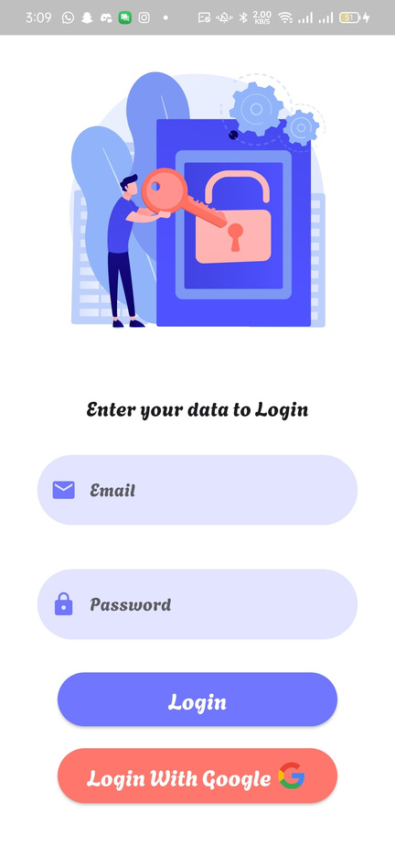

Slide 6
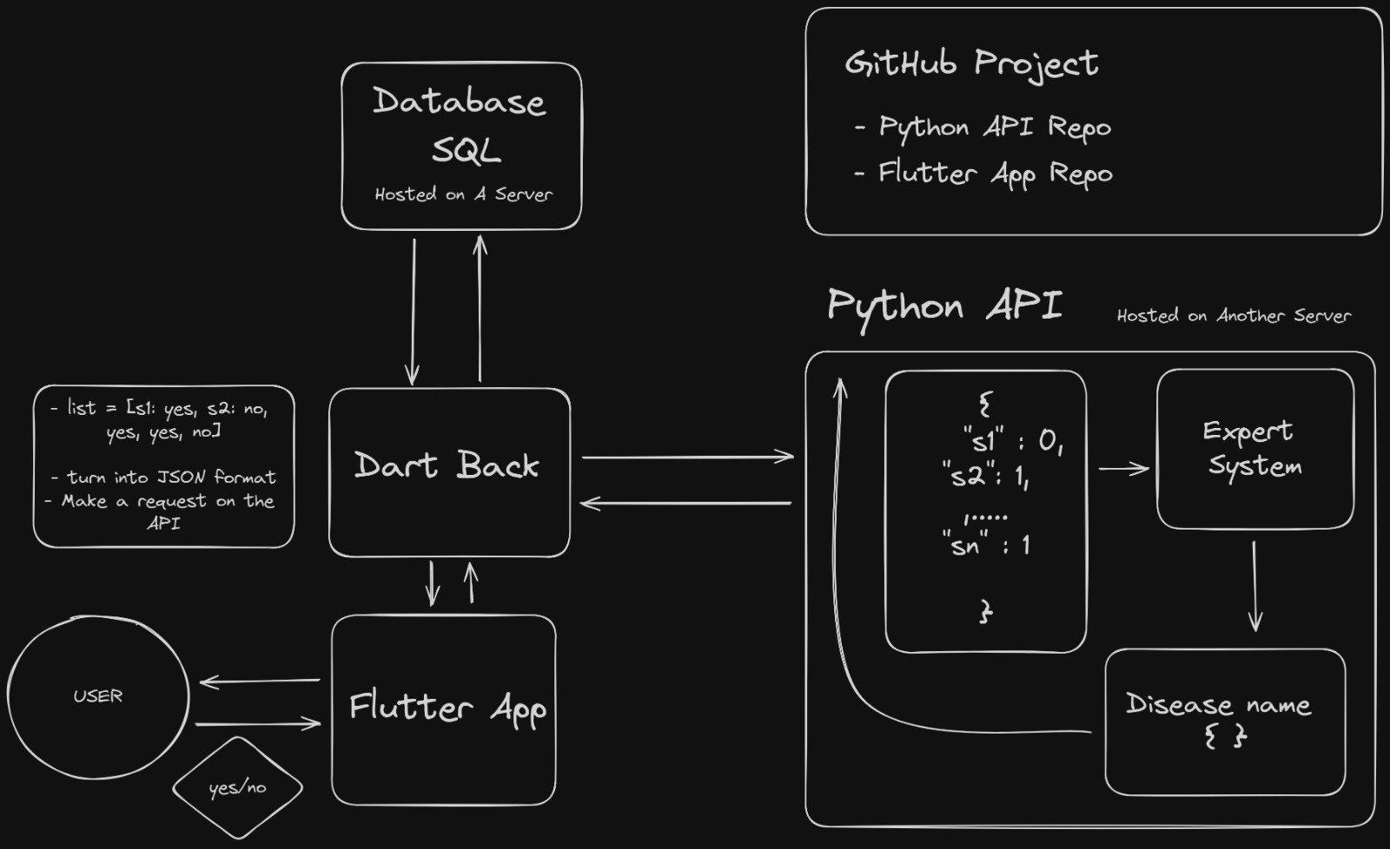

Slide 7

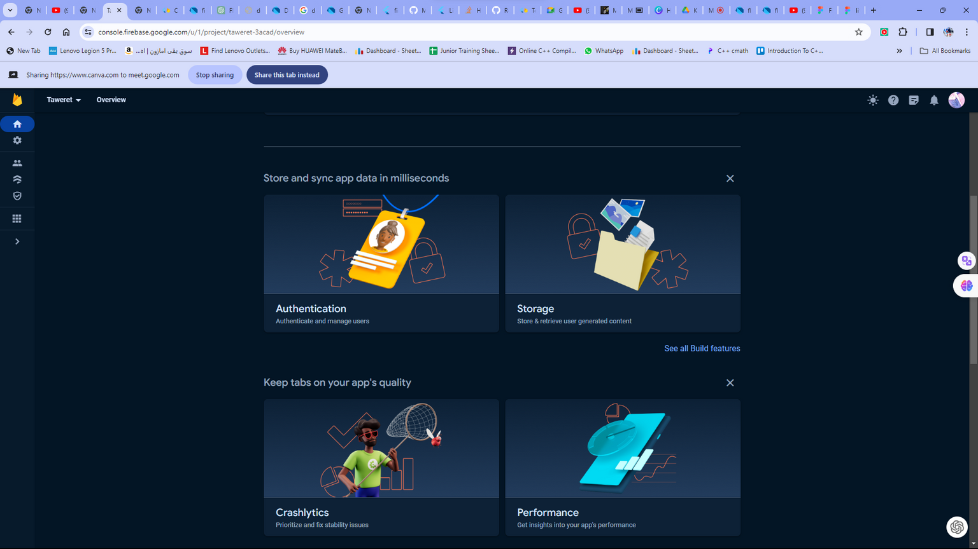
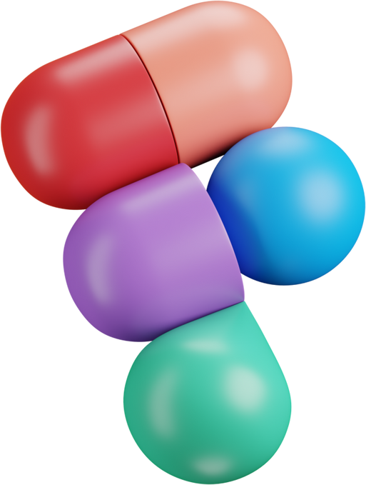
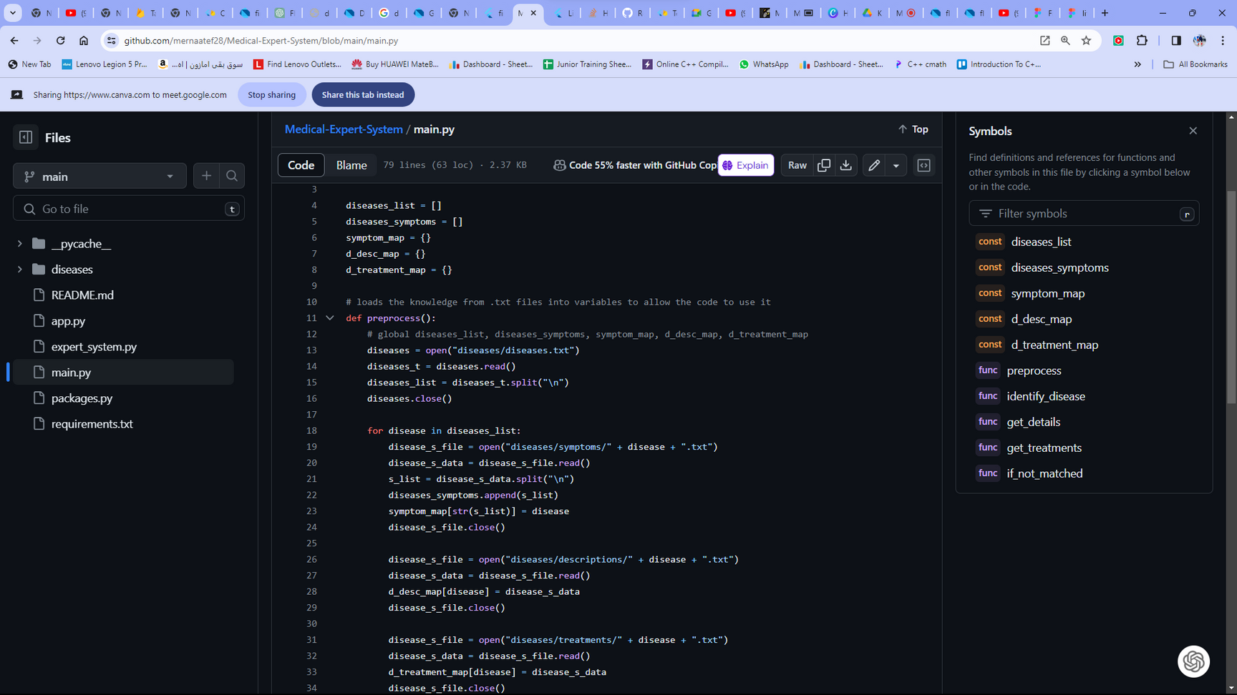


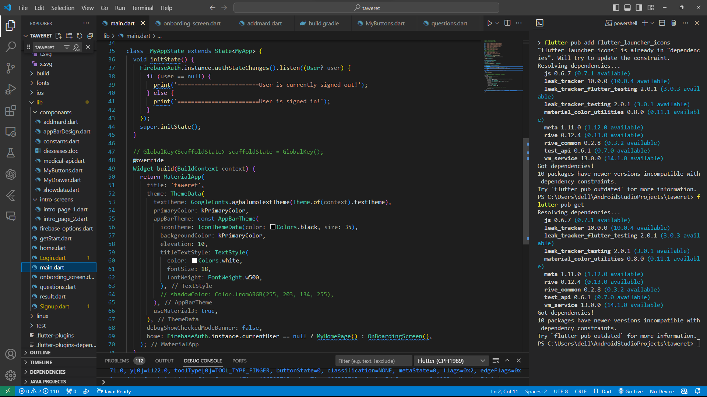
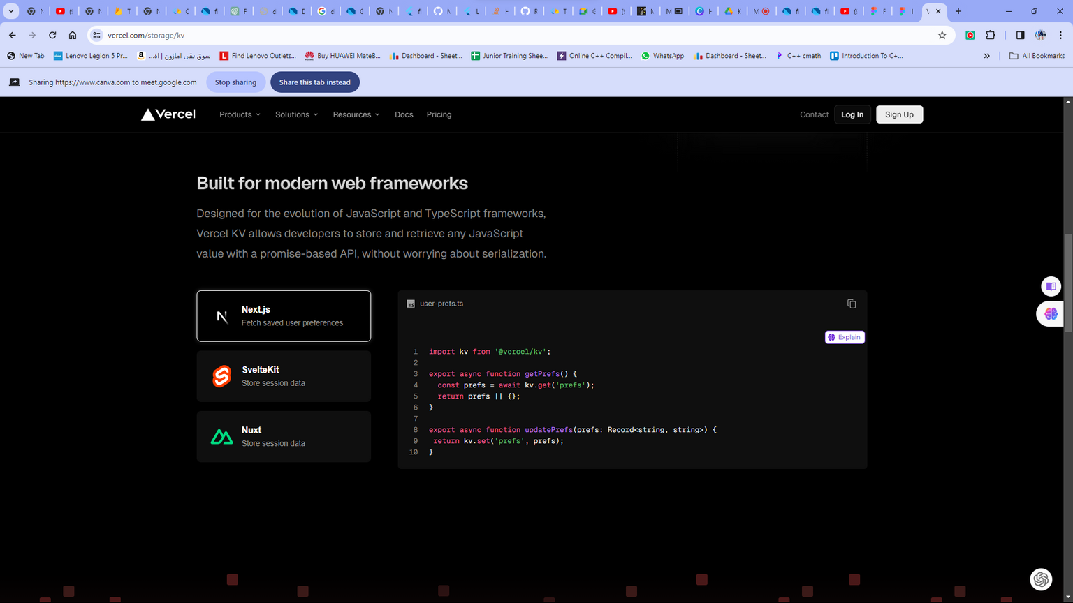



Slide 8
COMING SOON
kiddr for newborn mommy's
kiddr for fast check on your health

Slide 9

Track your health with a touch

Slide 10
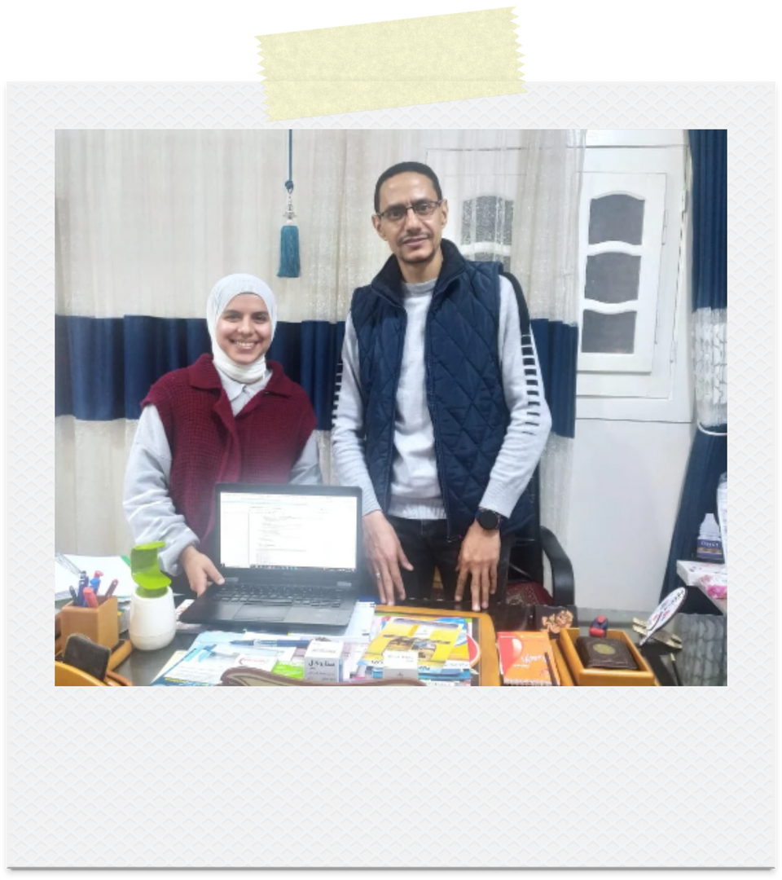
Meet our experts
Dr.Osama Elhakem
Pediatric specialist
(kids-diseases)

Slide 11

Gehad Ahmed
Data analysis / backend
MEET OUR TEAM
mark magdy
UI developer
Gehad Mamdouh
Data analysis
kiddr
Ismail Sherief
Backend developer
(API)
Rawan said
UI developer
Merna Atef
Backend developer
(flutterfire)

